Slide 1

Unicycle project

Slide 2
Outline
Introduction
Framework
Diff. Flatn L & NL
Outpput state
parking

Slide 3
Introduction: the "urban mobility challenge"
Problem: An autonomous guided vehicle (AGV) has to travel along a closed circuit avoiding the other AGVs that are parked along the path; at the completion of one lap, the AGV has to get off the circuit and park at the box
PROJECT OBJECTIVES:
Track a closed trajectory
Avoid obstacles on the trajectory
After performing one lap, reach an empty parking lot

Slide 4
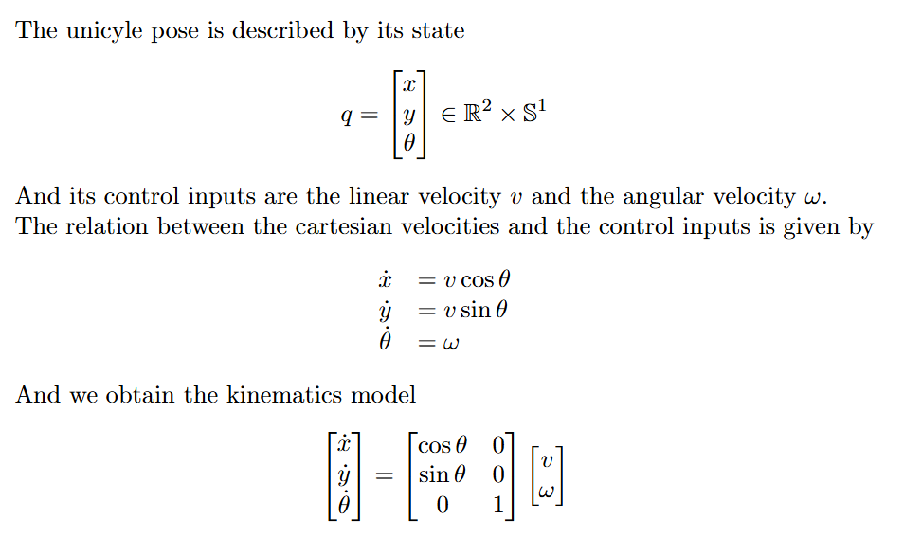
Framework: unicycle
θ
y
The AGV used in the project is a unicycle, a planar vehicle which is described by its state
x

Slide 5
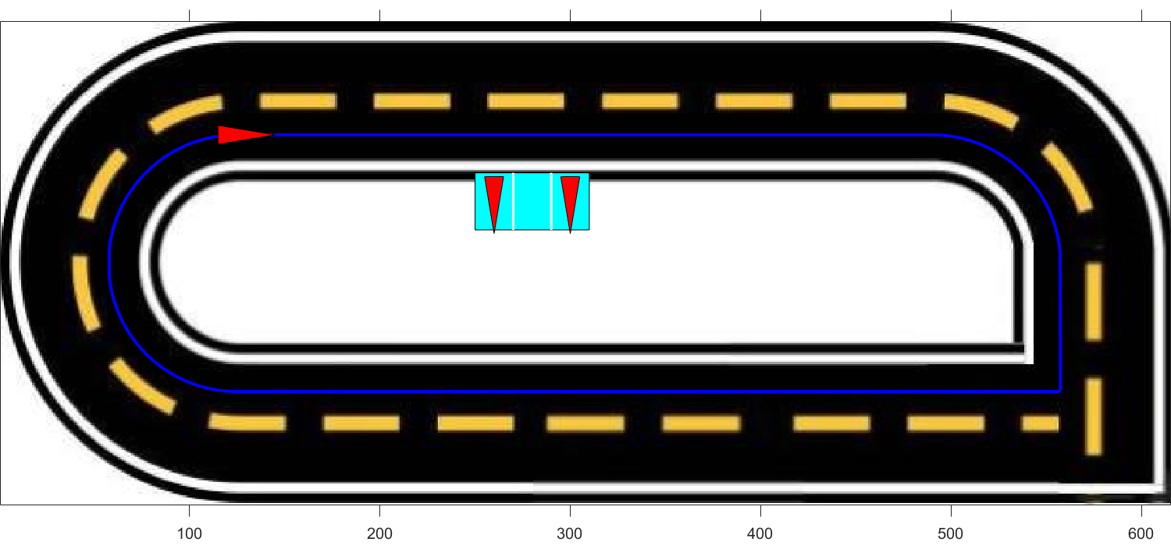
Framework: trajectory
To design the desired trajectory, a series of waypoints was defined. These waypoints were then interpolated using cubic spline interpolation to ensure a continuous path
To test controllers' functionalities on a non-continuous path, a sharp square-angle turn is added to the path

Slide 6
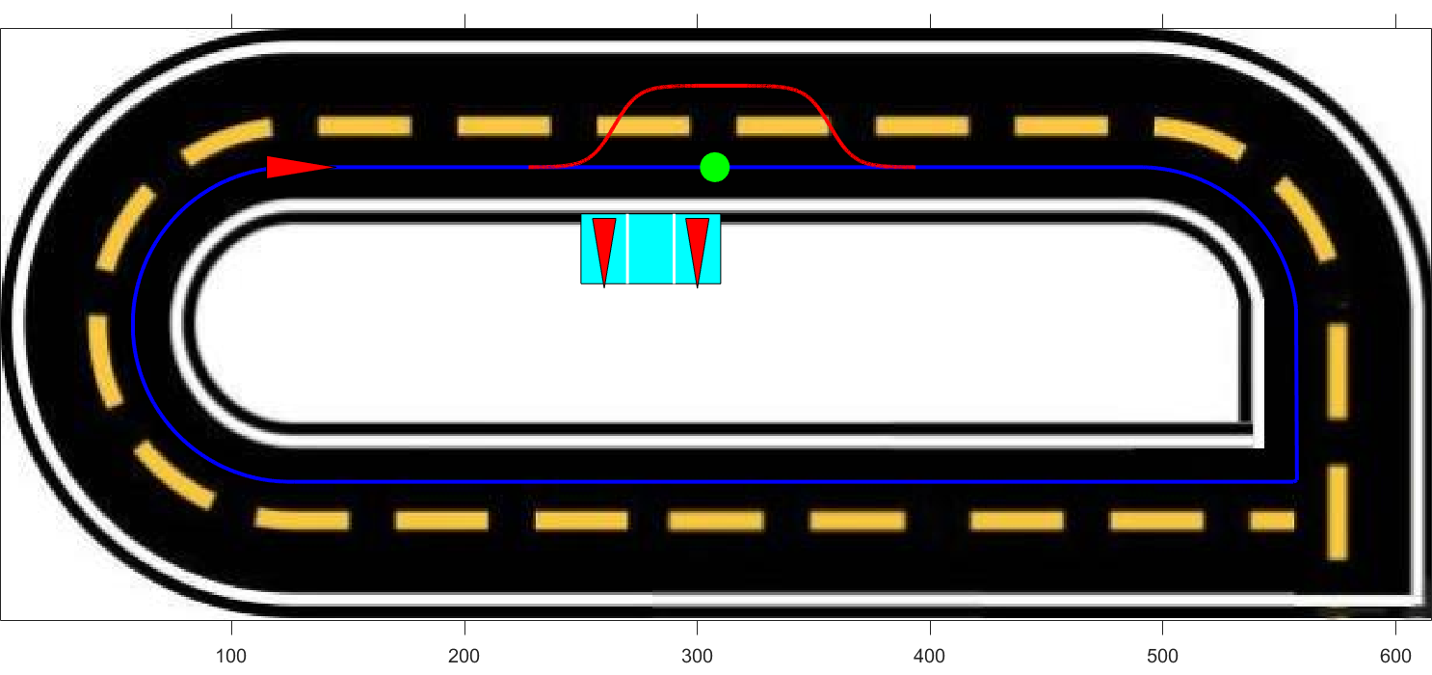
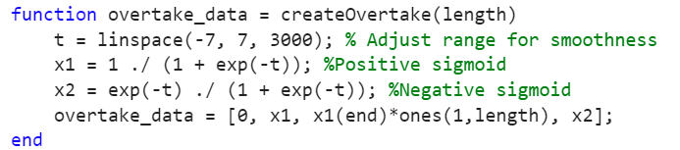
Obstacle avoidance
The unicyle after detecting the obstacle progressively reaches the second lane, after overtaking the obstacle it progressively returns to the first lane
To ensure a smooth and continuous trajectory during the changing lane procedure a sigmoid function has been used

Slide 7
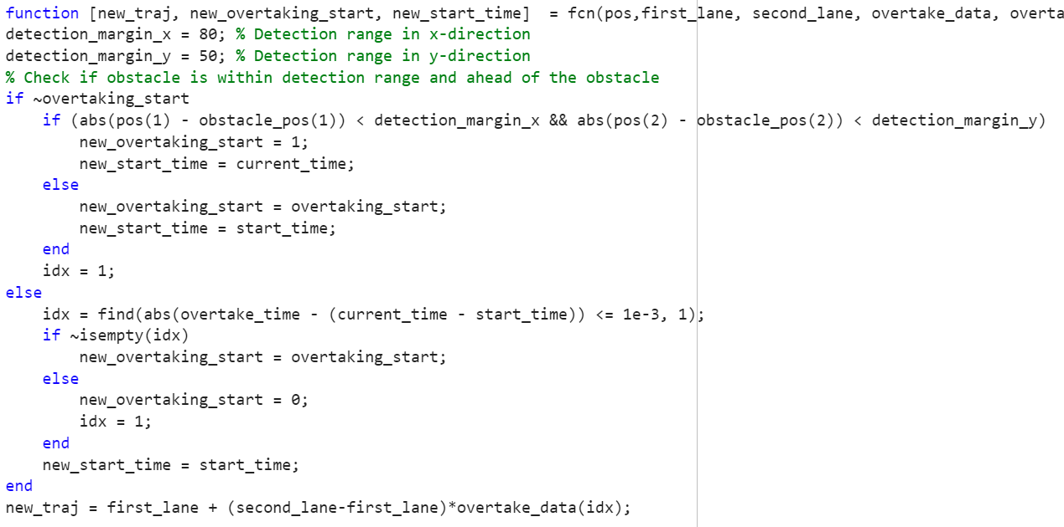
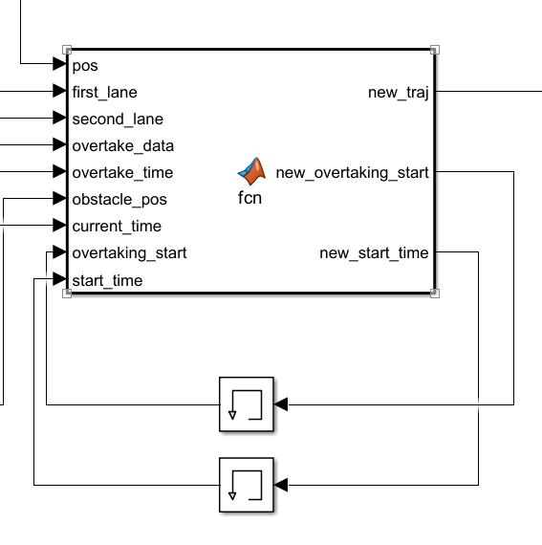
Obstacle avoidance

Slide 8
TRAJECTORY TRACKING - STATE ERROR FEEDBACK

Slide 9
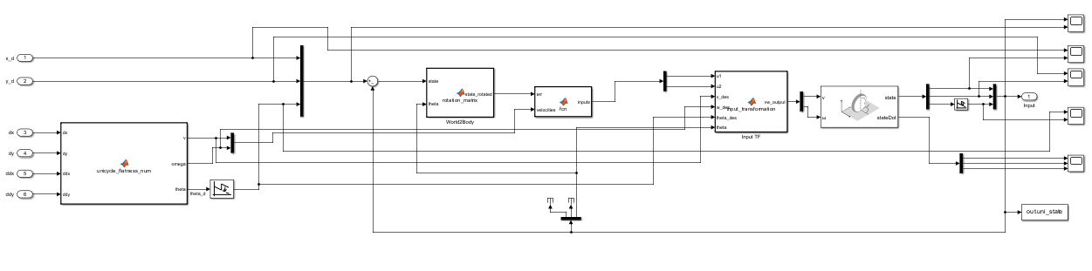
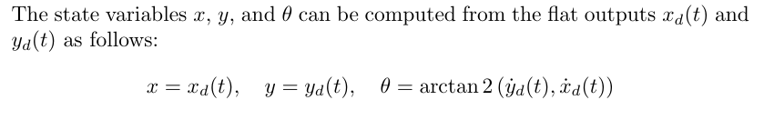
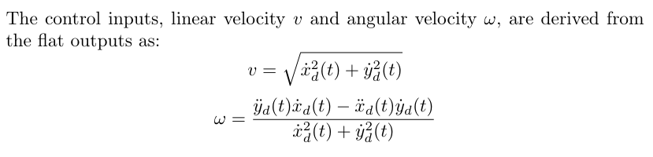
Linear case
Explain that we can not guarantee asymp convergence cause system TV, but we do have convergence property cause we are doing rectilinear and semicircular motions so someway we are covered by good convergence properties
explain also the wrap / unwrap thing ?
General overview --> explain the general strcuture, all the blocks and why

Slide 10
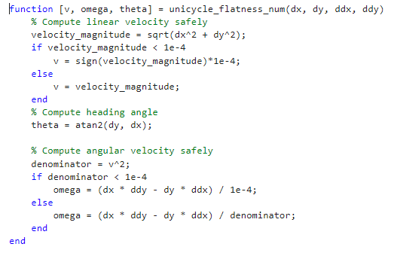
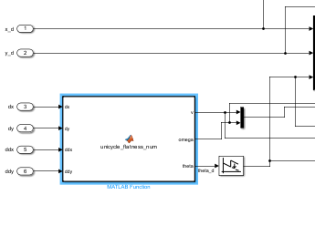
Avoiding division by zero

Slide 11
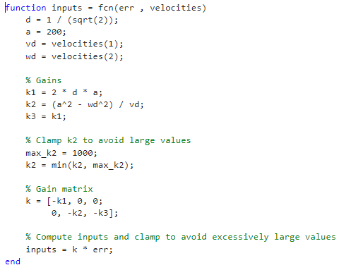
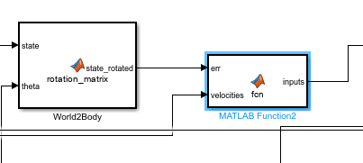
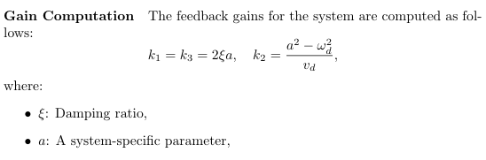
Gains and parameters --> gains: also plot where they lives ?

Slide 12
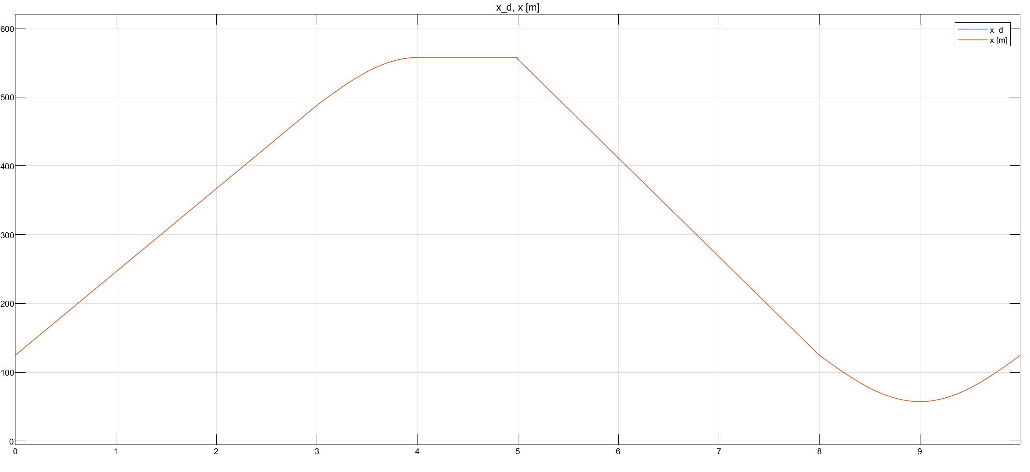

Slide 13
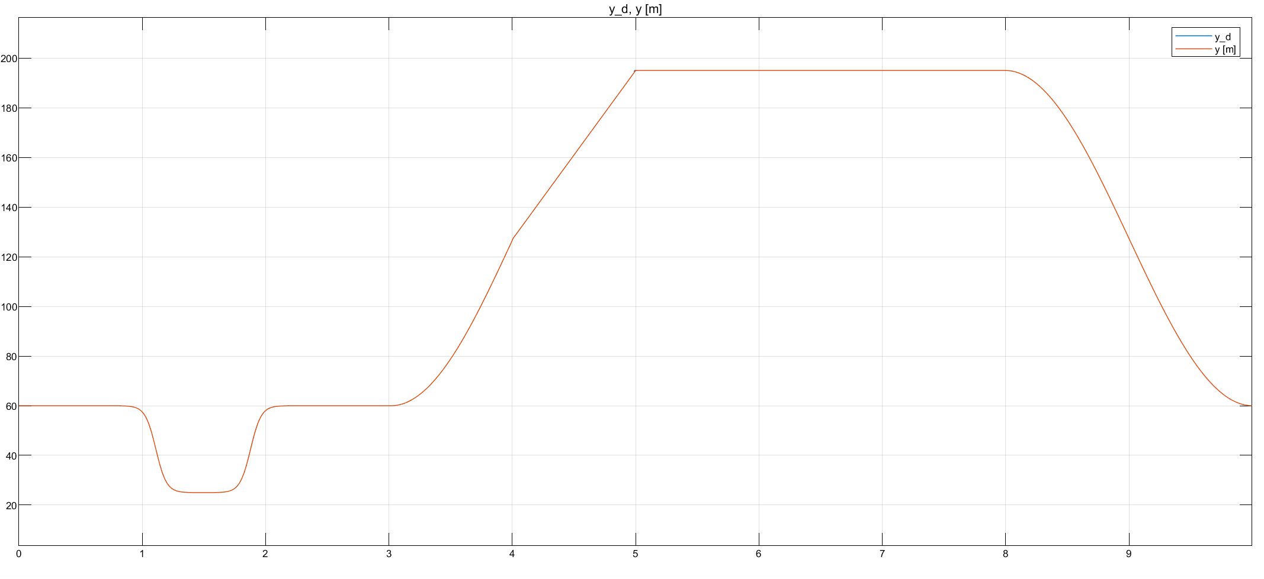

Slide 14
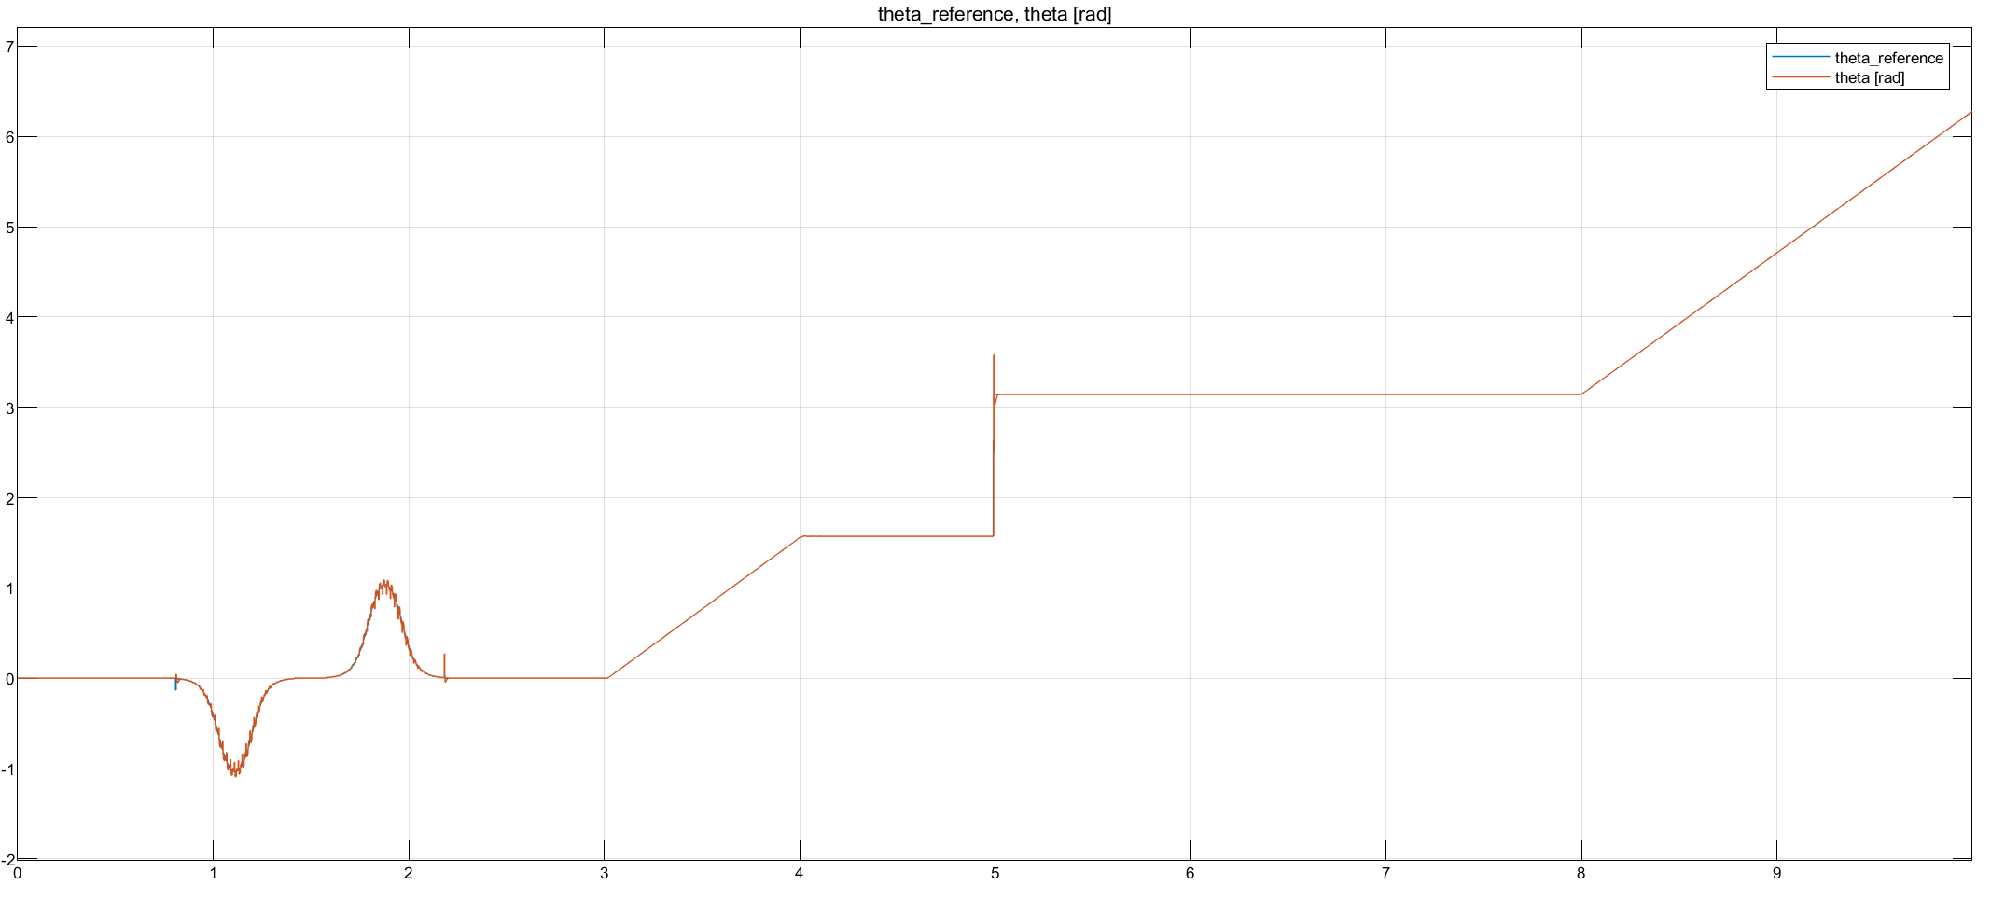
Cambia theta_ref in theta_d o cambia x_d , y_d e controlla che siamo giusto lineare questo grafico

Slide 15
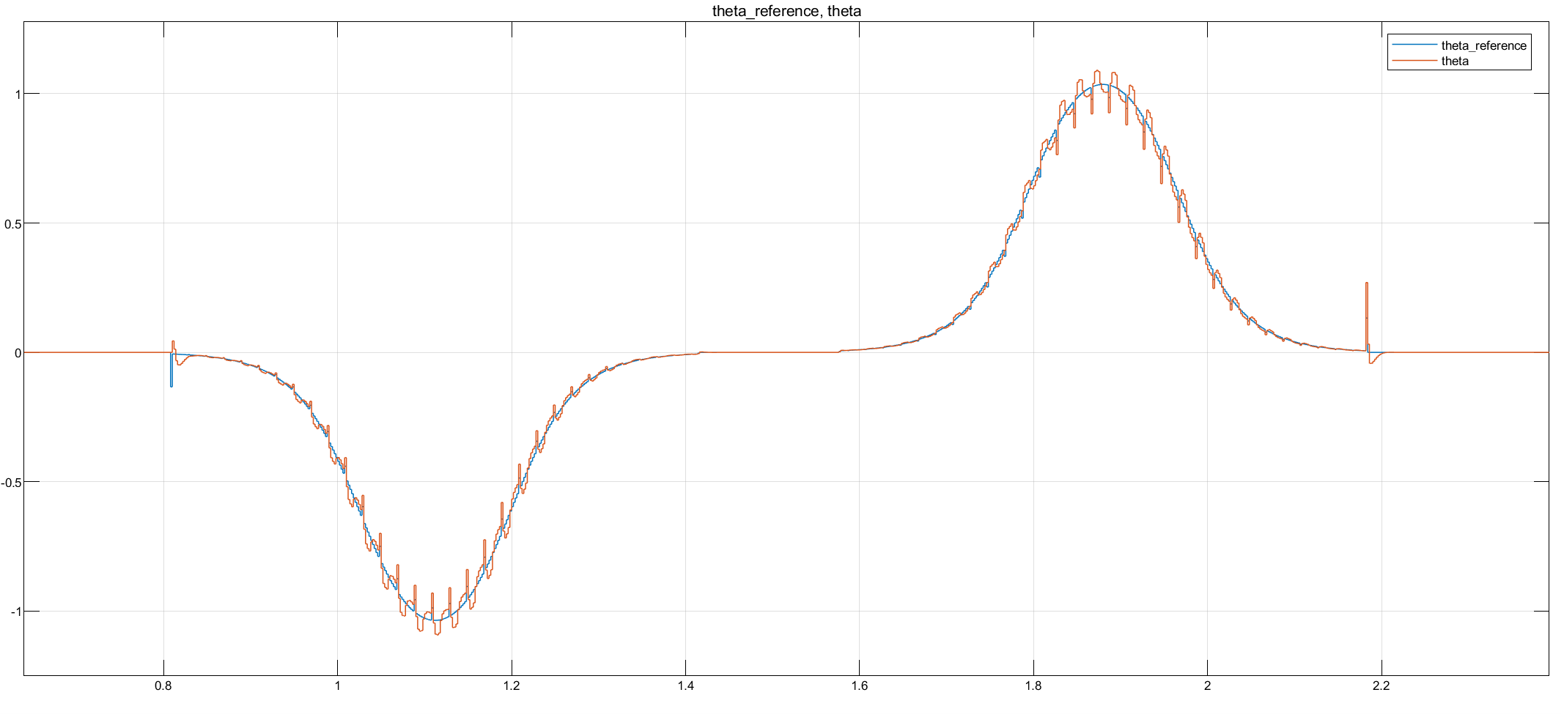

Slide 16
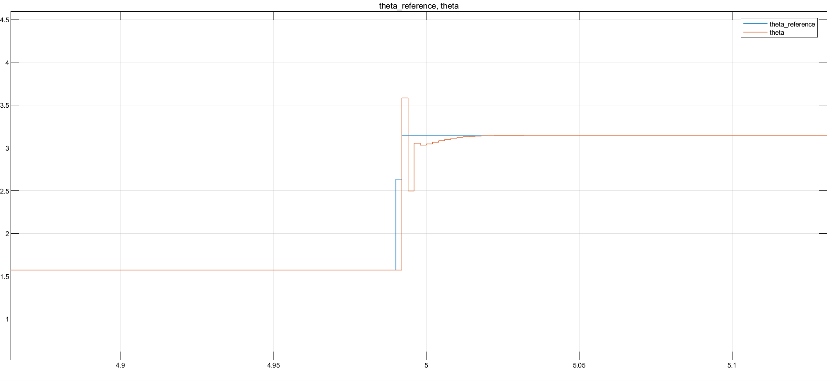
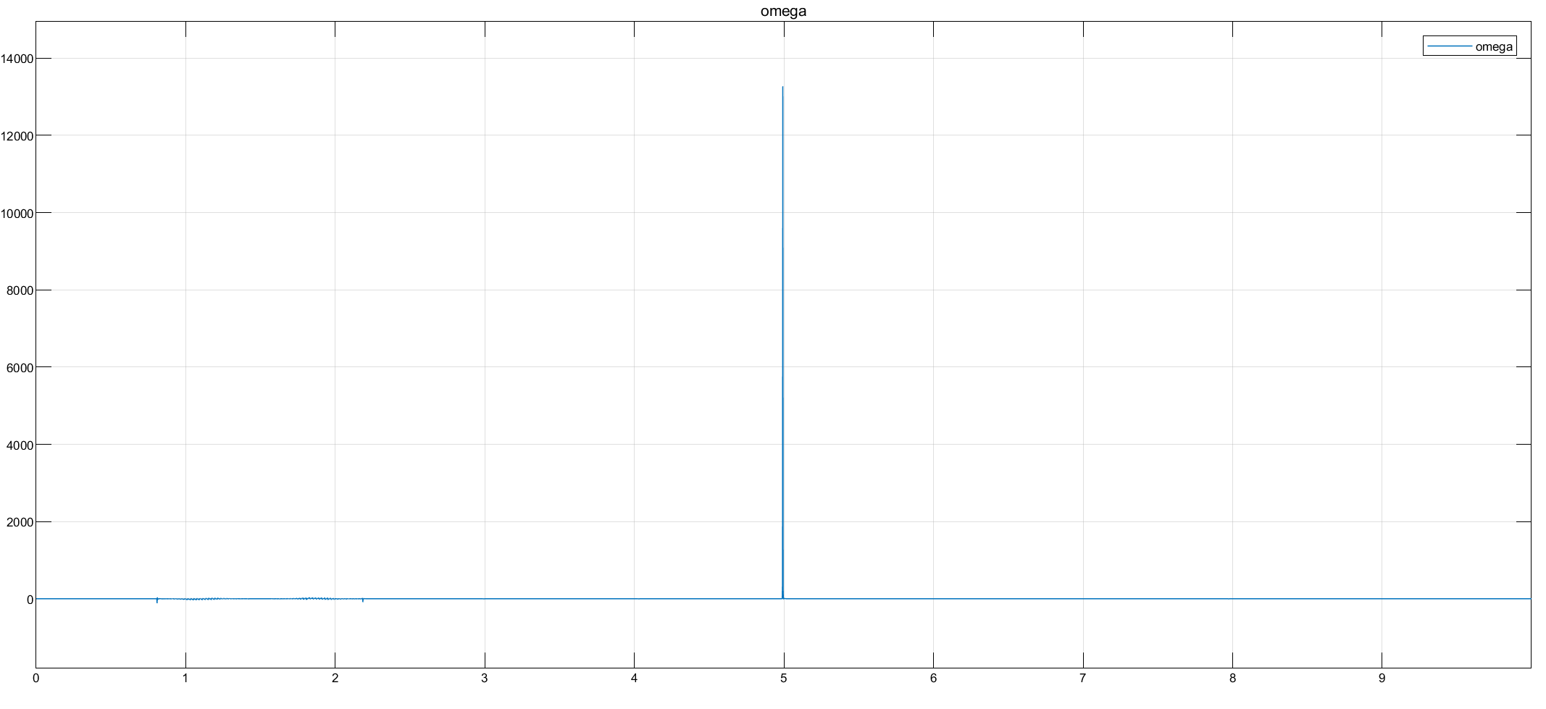
Focus on sharp curve
As expected from theory, differential flatness block should not be able to compute the input velocities when reaching a non differentiable part of the trajectory. Indeed, impulses in both velocities arises, with stronger effect in omega, (its computation is based on the second order derivative).
Nonetheless, thanks to Simulink implementation of the derivative we have been able to overcome the problme and to finish the simulation anyway.

Slide 17
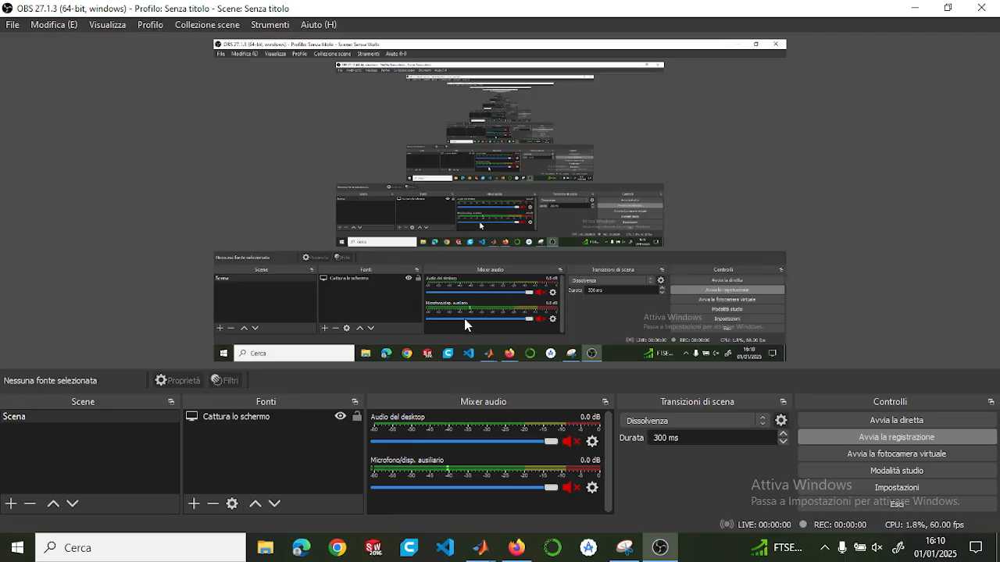
Video
Sistemare e tagliare video

Slide 18
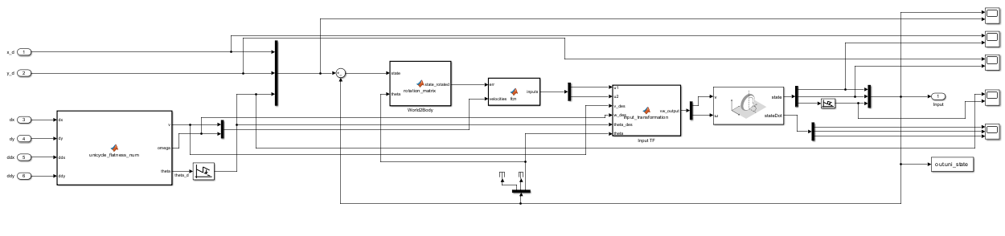
Non Linear case
NON LINEAR controller --> same structure , security checks … but different gain computations
explain also the wrap / unwrap thing ?
General overview --> explain the general strcuture, all the blocks and why

Slide 19
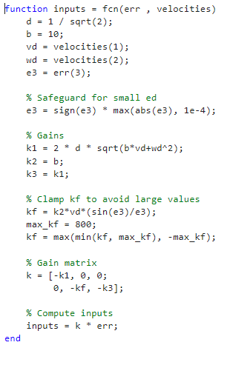
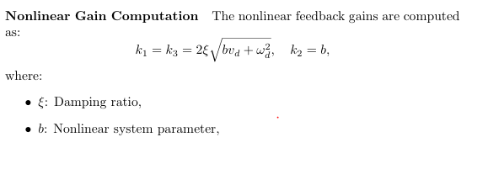
Gains and parameters

Slide 20


Slide 21
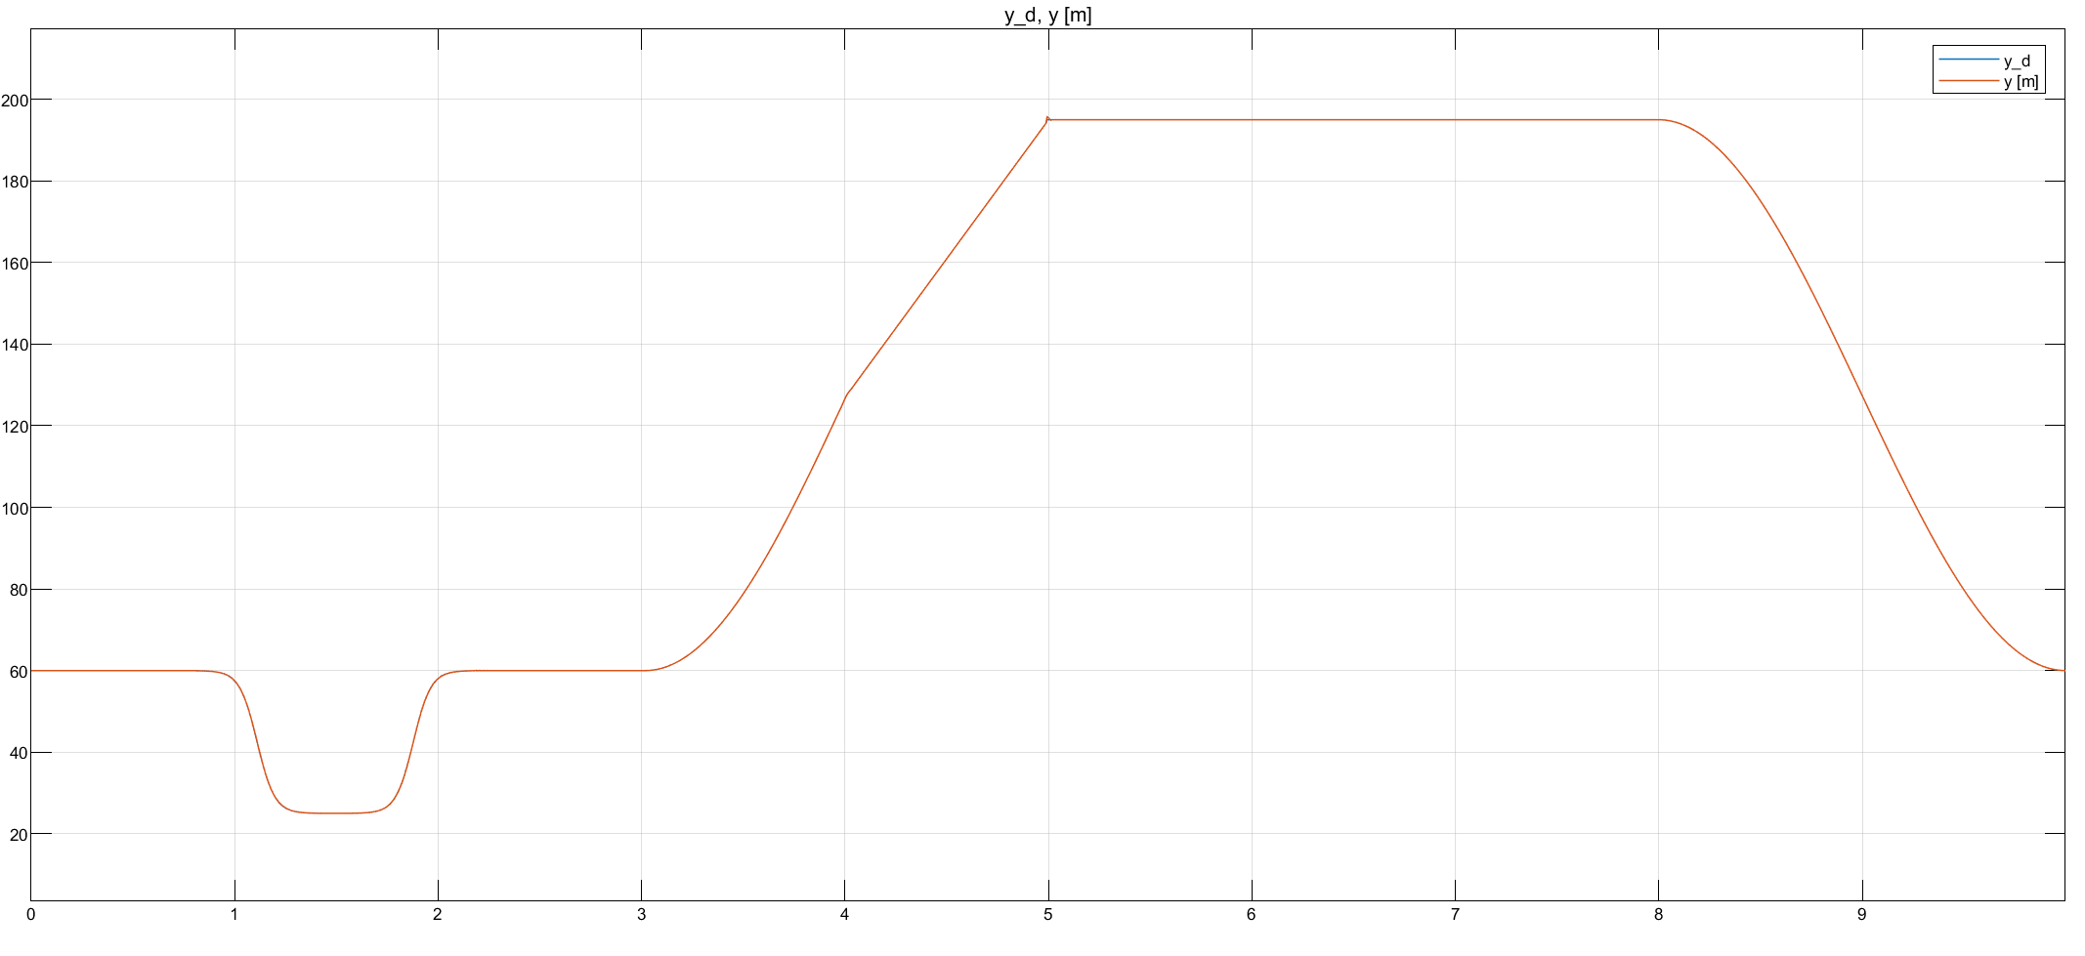

Slide 22
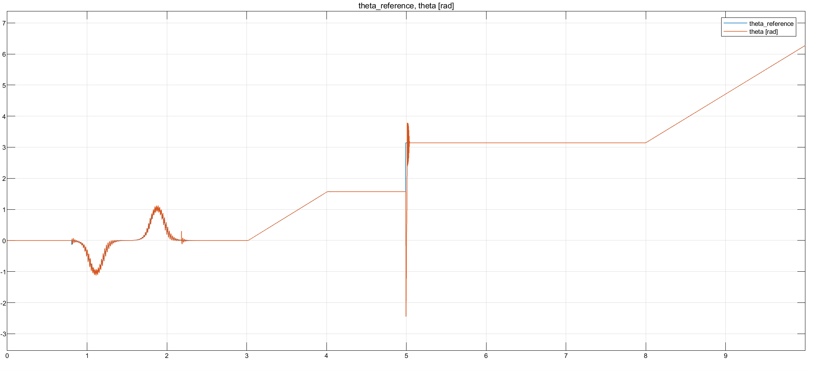
Plots --> see if impulse bigger than linear case follows some theoretical thing or just related to gains tuning

Slide 23
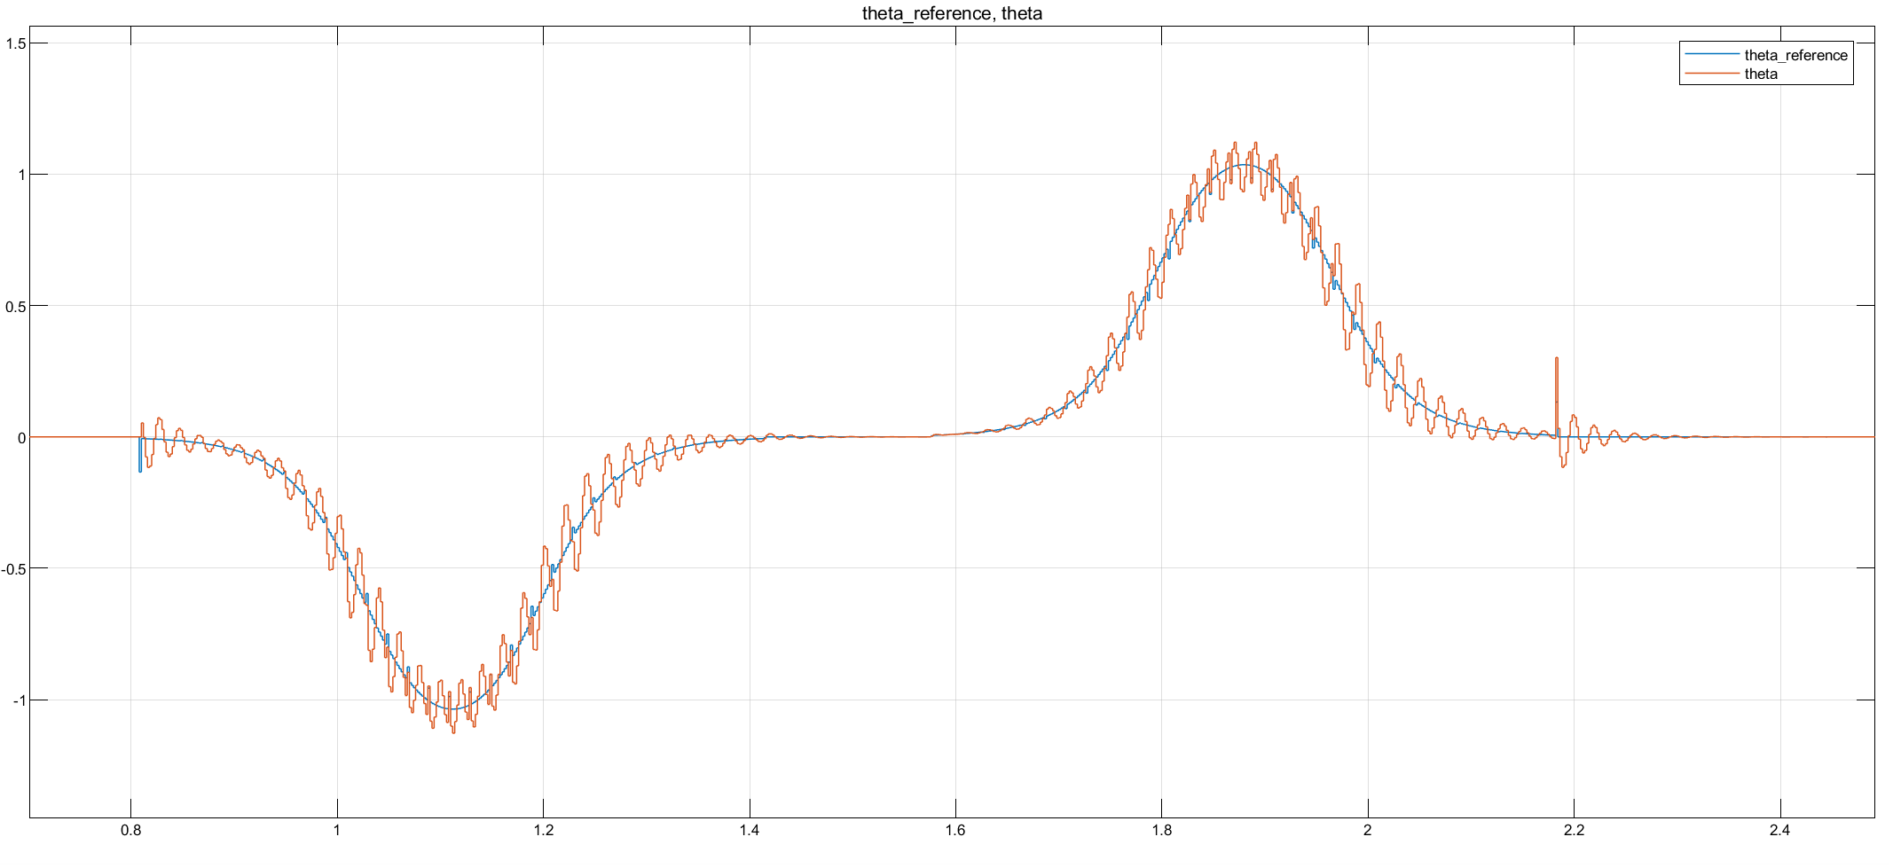

Slide 24
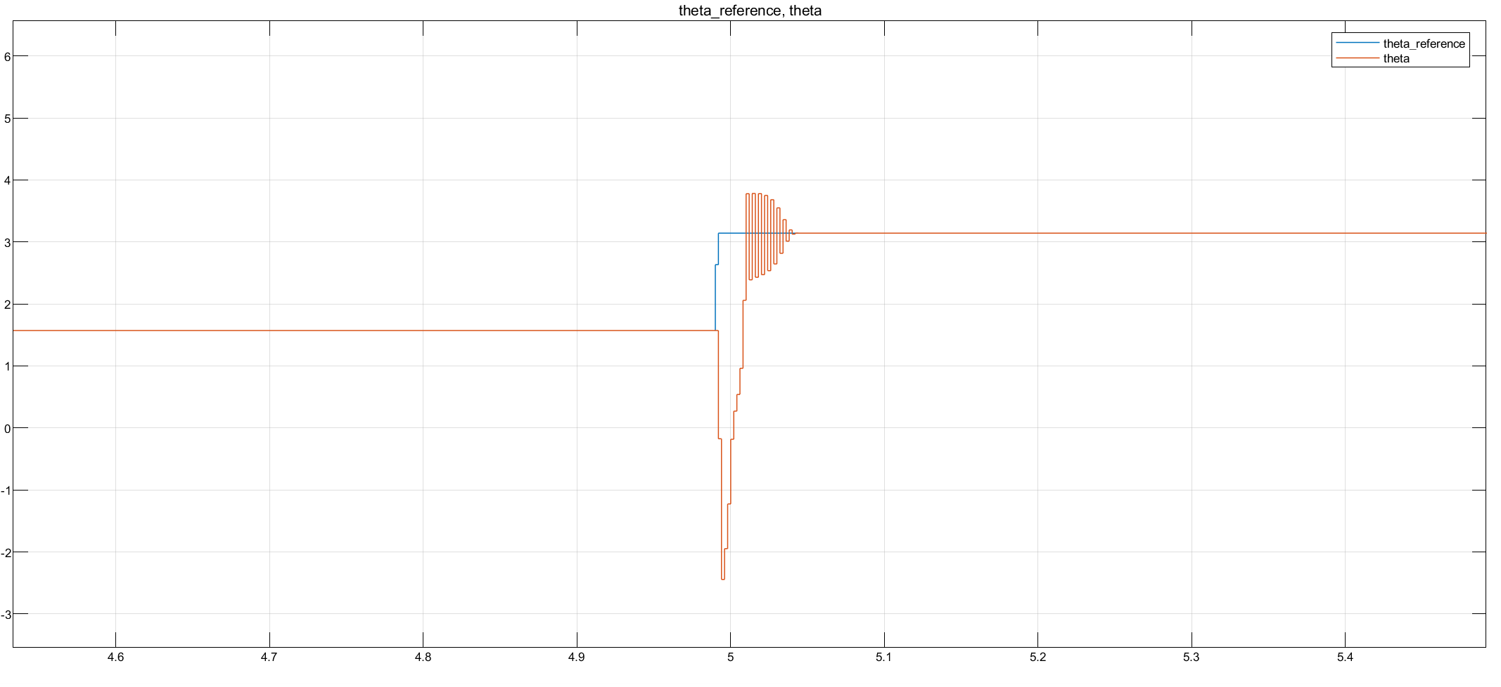
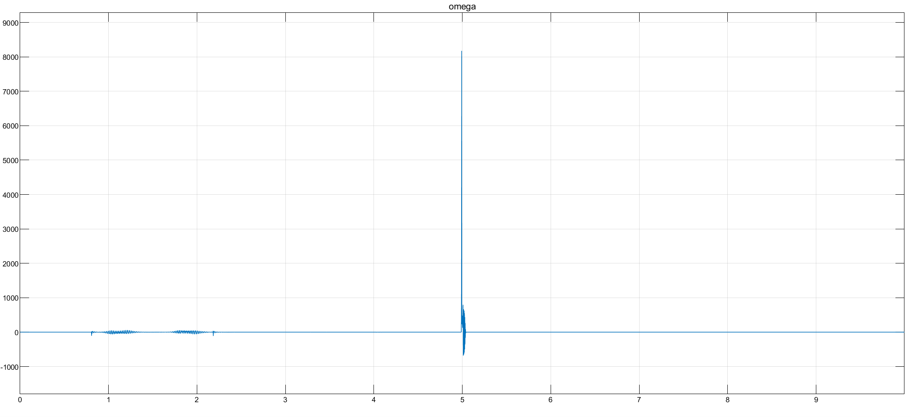
Focus on sharp curve
Make a consideration regarding NL more enhanced wrt lineare case, maybe theres a reason

Slide 25
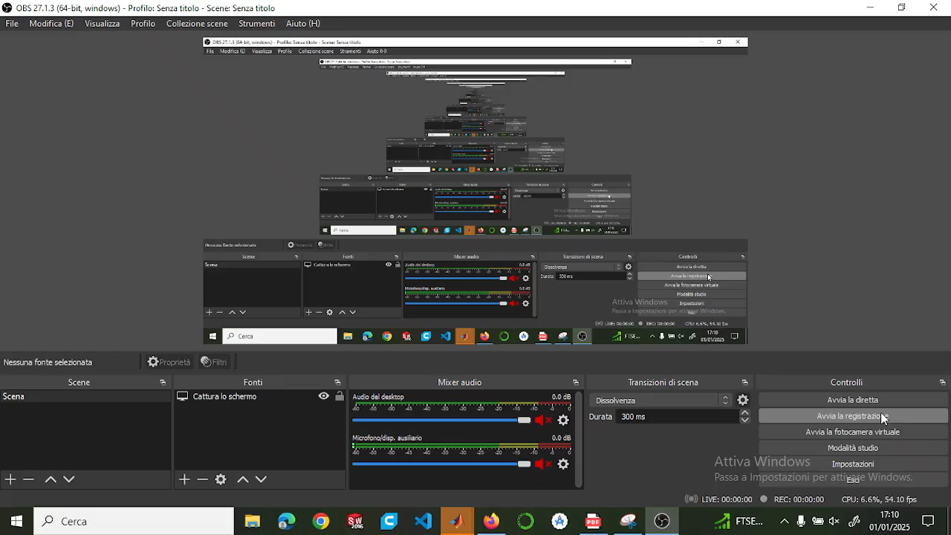
Video
Sistemare e tagliare video

Slide 26
TRAJECTORY TRACKING - OUTPUT ERROR FEEDBACK

Slide 27
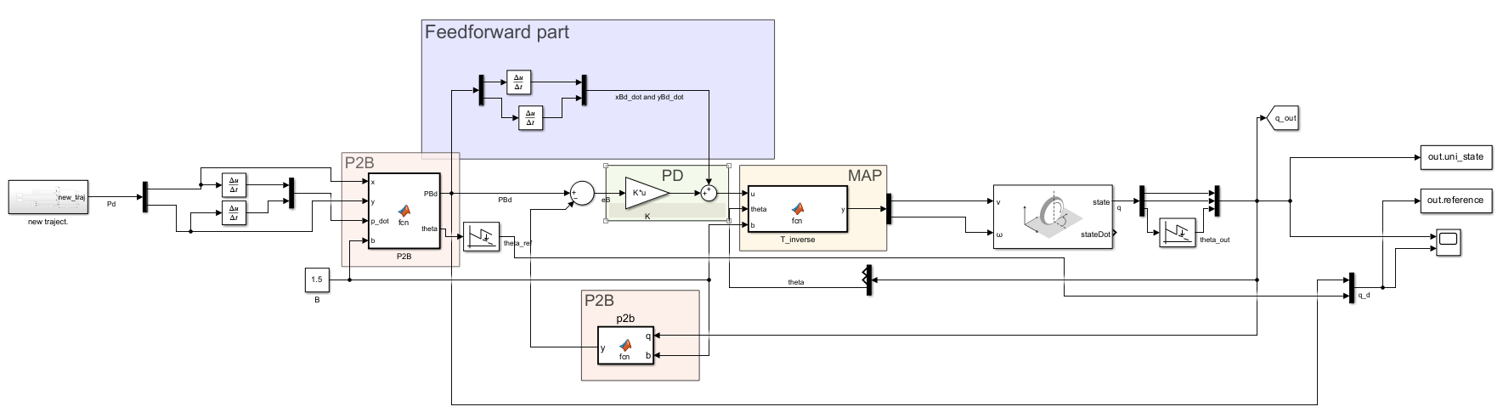
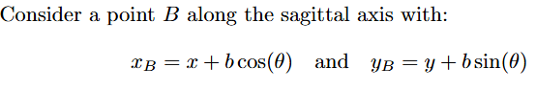
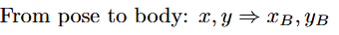
Feedback linearization based on a reference point on the sagittal axis

Slide 28
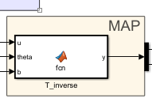
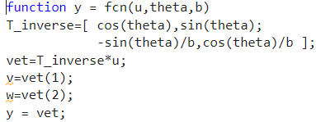
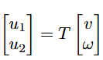
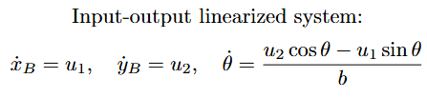
Map

Slide 29
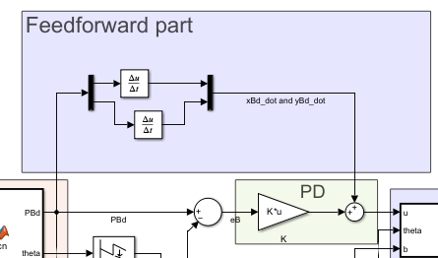
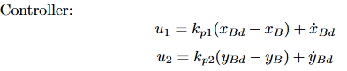
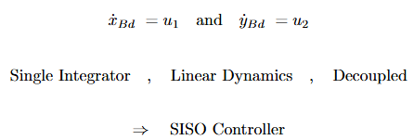
Controller design
Pro:

Slide 30
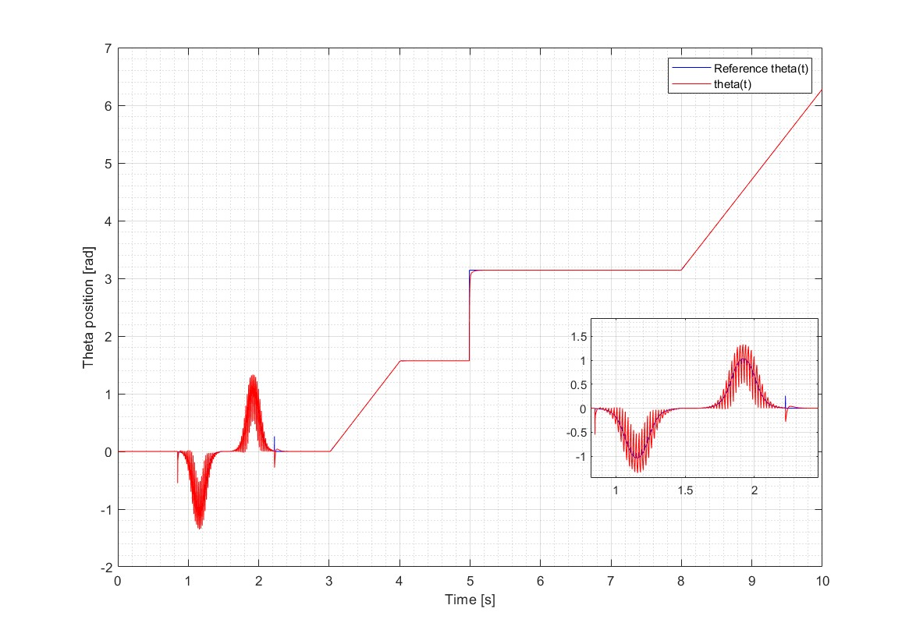
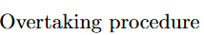
Plot

Slide 31
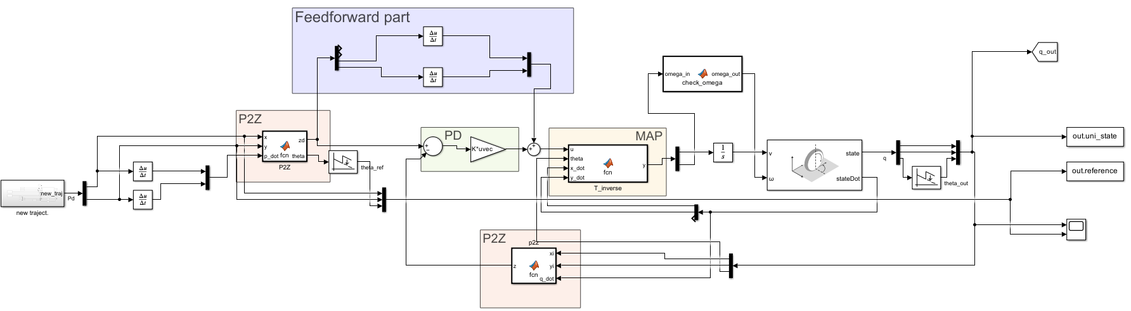
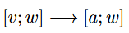
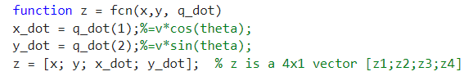
Feedback linearization based on second order derivatives

Slide 32
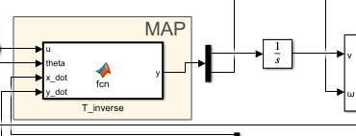
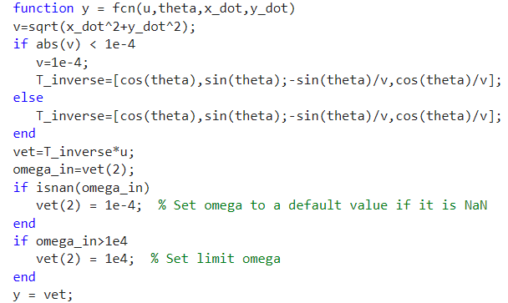
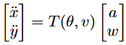
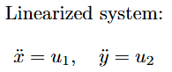
Map

Slide 33
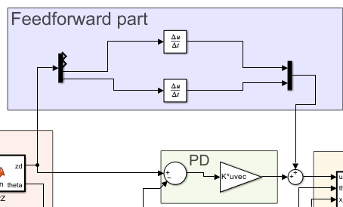


Controller design
Need:

Slide 34

Plot

Slide 35


Plot

Slide 36
REGULATION

Slide 37


Cartesian regulation

Slide 38



Control law

Slide 39

Pose regulation

Slide 40


State trasformation

Slide 41


Control law

Slide 42

Plots of all controllers together

Slide 43


Slide 44


